Slide 1

Training Programs Marketplace
- Web scraping from Coursehorse.com
Choutine Zhou
May 9th 2017
Notes:
how to determine the next popular course

Slide 2
Background
CourseHorse .com is a marketplace to review and buy courses
Casual Classes
Professional Development Programs
Notes:
cooking, art and fitness
business communication, coding and big data

Slide 3
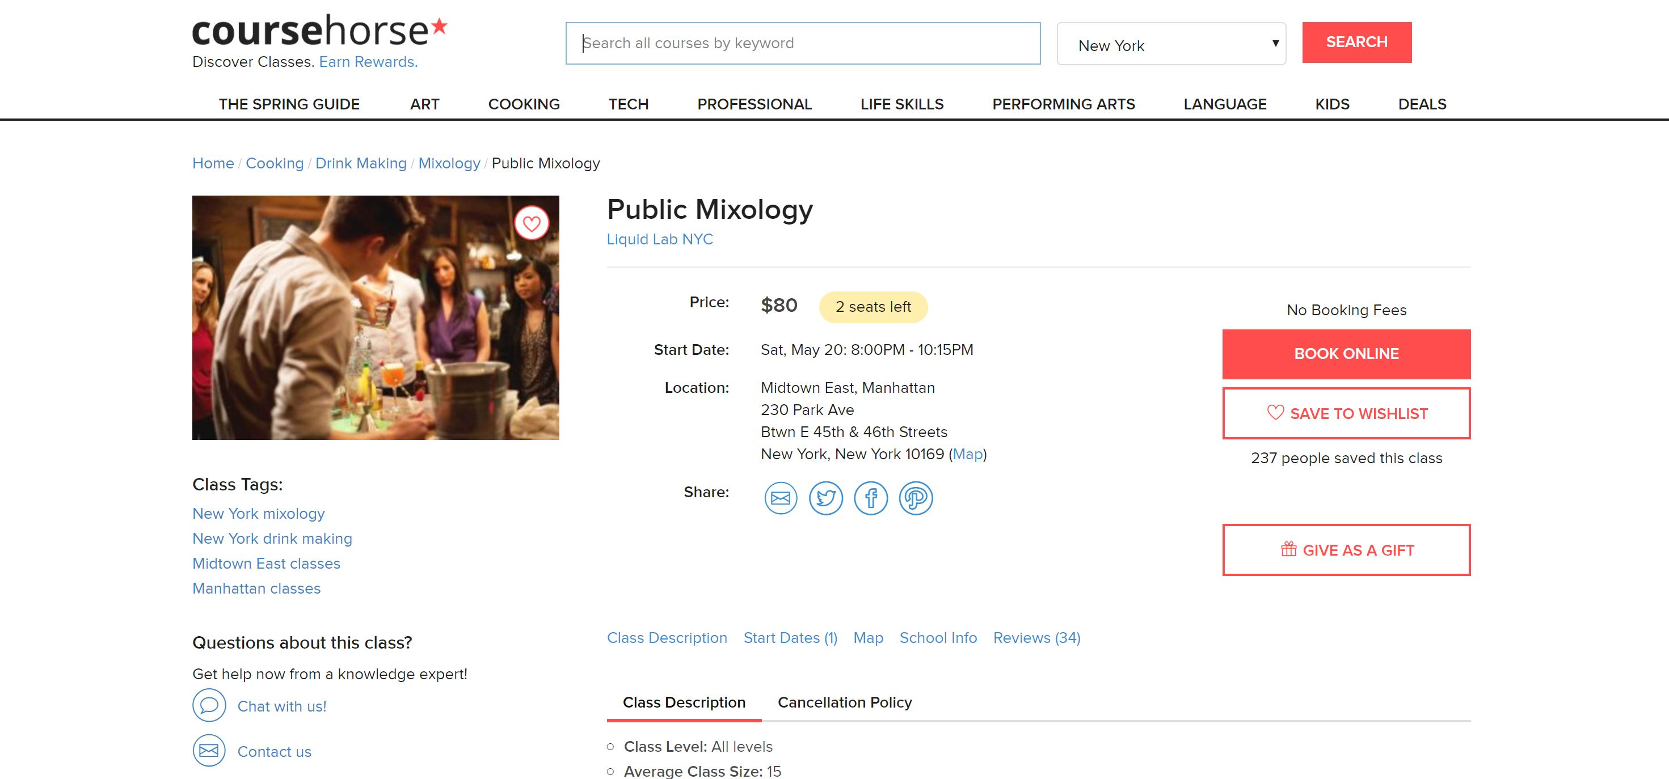

Slide 4
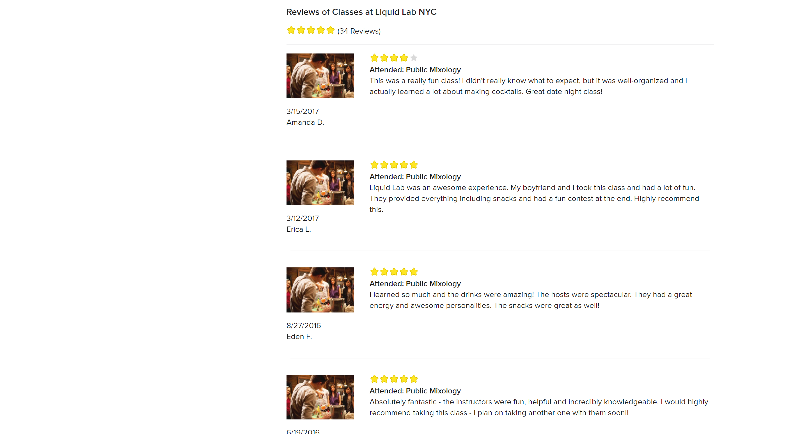

Slide 5
About the Data
15,000+ Observations, 17 Variables
6 Cities: New York, Boston, Chicago, Houston, Nashville, Los Angeles
Notes:
Main variables:
Course name
School name
Address
Categories / Subcategories
No. of Saved
Course Description
Rating

Slide 6




Motivation
Questions:
What are the supply and demand of the course offerings?
Audience: Continuing Education Institutions / Education Entrepreneurs
Notes:
For business purpose, what is the next new course to open?

Slide 7

Assumption
Supply
proportion of the courses on this website
fairly represents the market
Demand
showed interests represent the demand of a courses
Notes:
Popularity of a type of courses

Slide 8
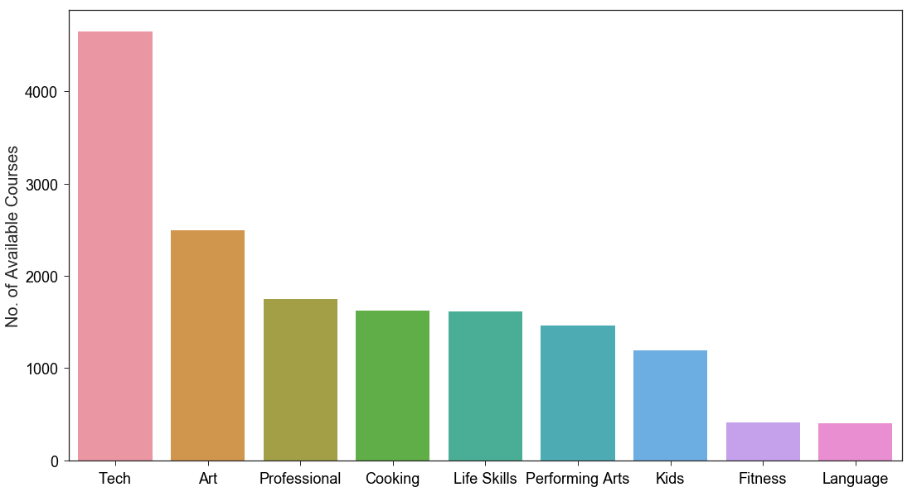
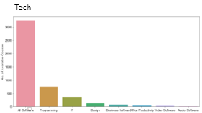

Overview

Slide 9
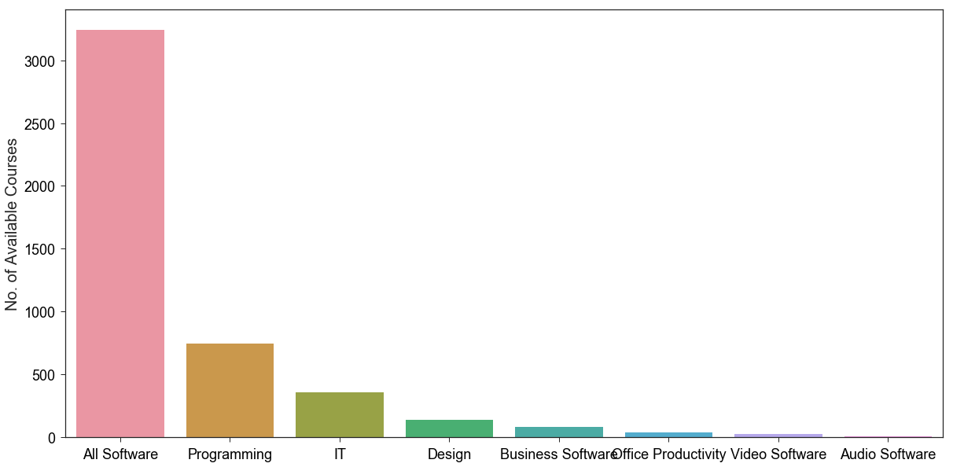
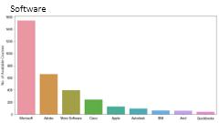
Tech

Slide 10
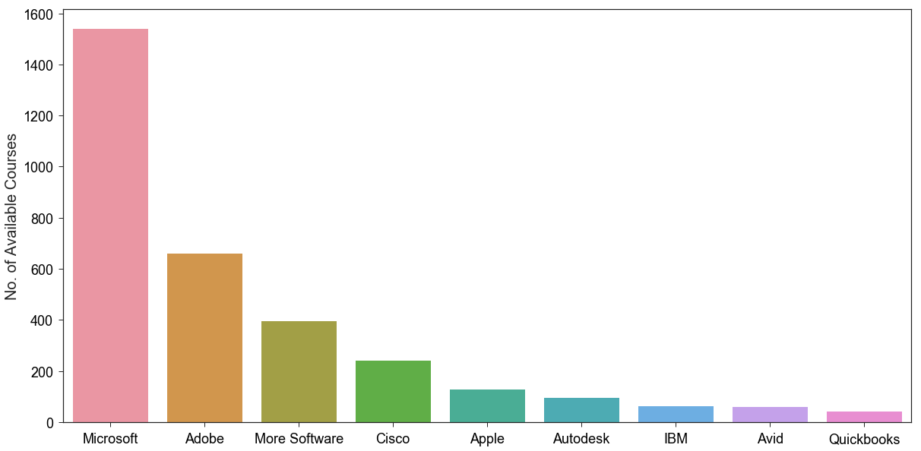
Software

Slide 11

Measurement
Among all types of sub-categories
Supply: % of Amount of Course
Demand: % of Sum Amount of “ Saved to Wish List”
Supply ≈ Demand

Slide 12
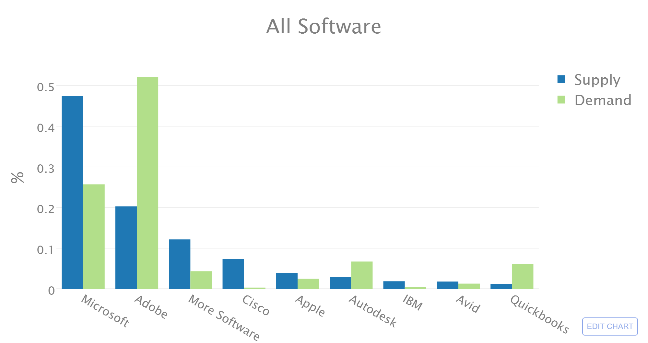

Slide 13
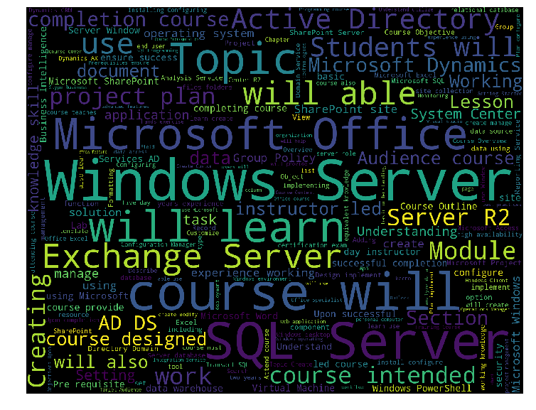
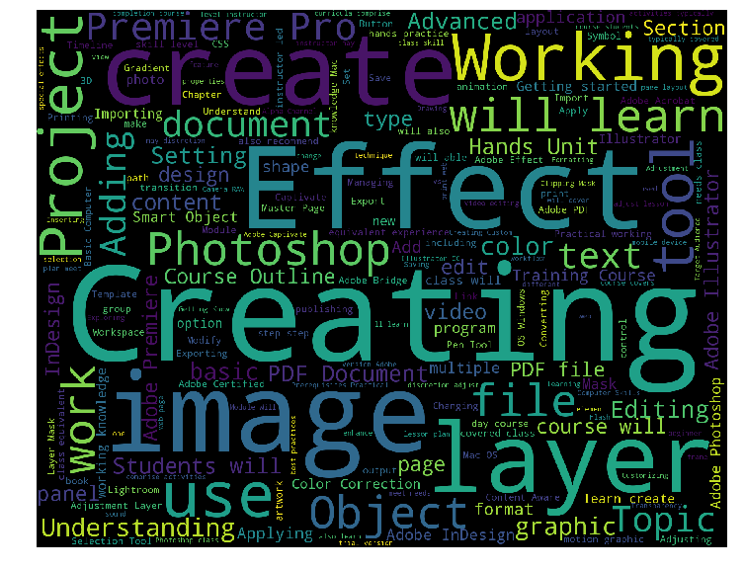
Microsoft Adobe

Slide 14
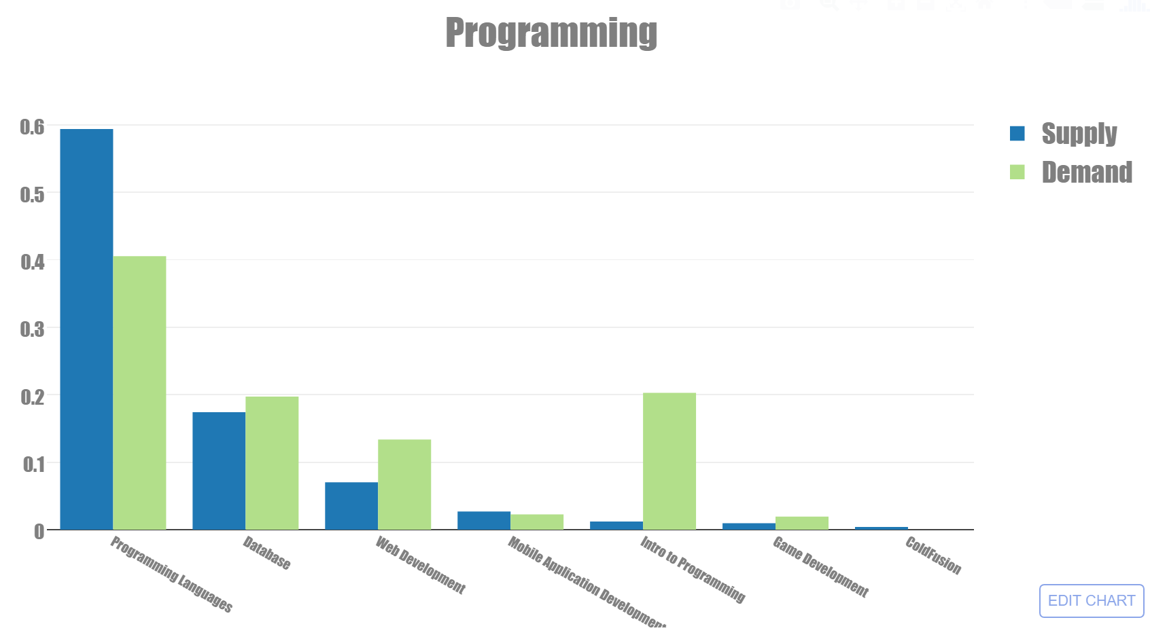

Slide 15
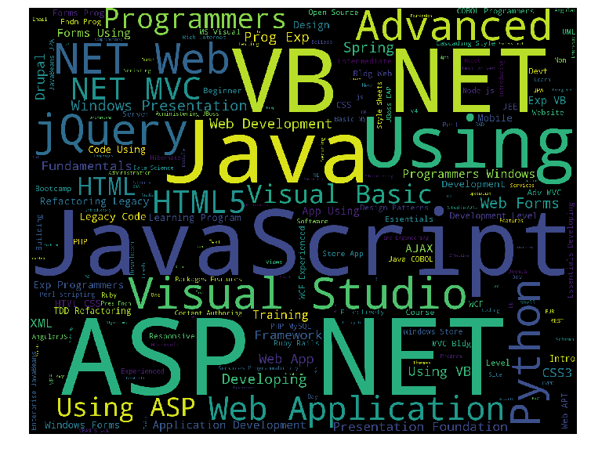
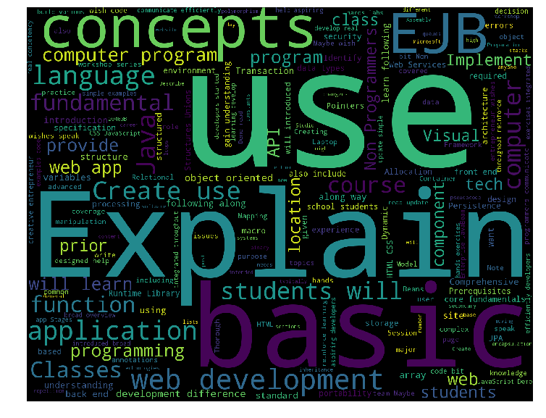
Programming Languages Intro to Programming

Slide 16
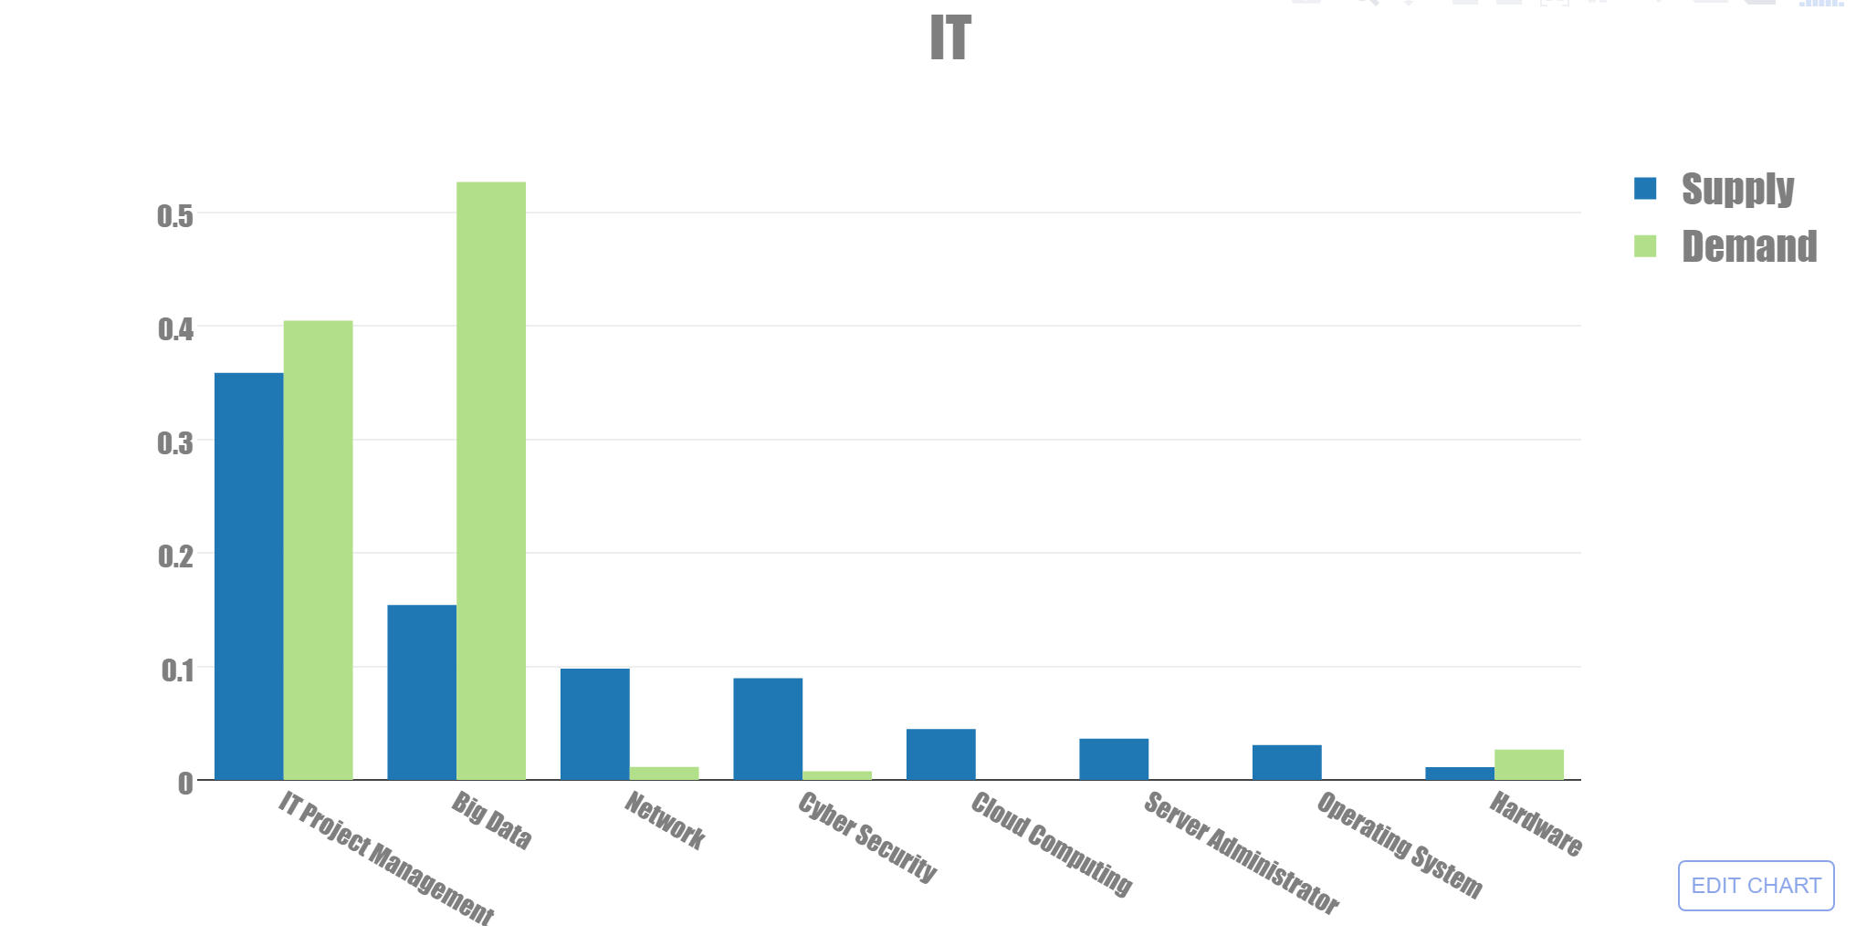

Slide 17
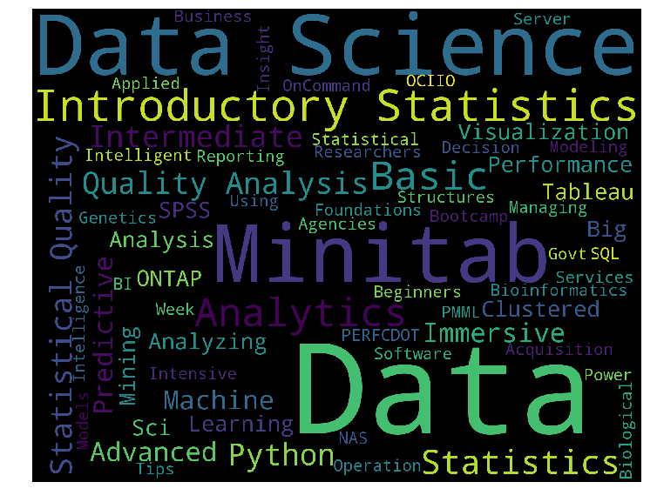
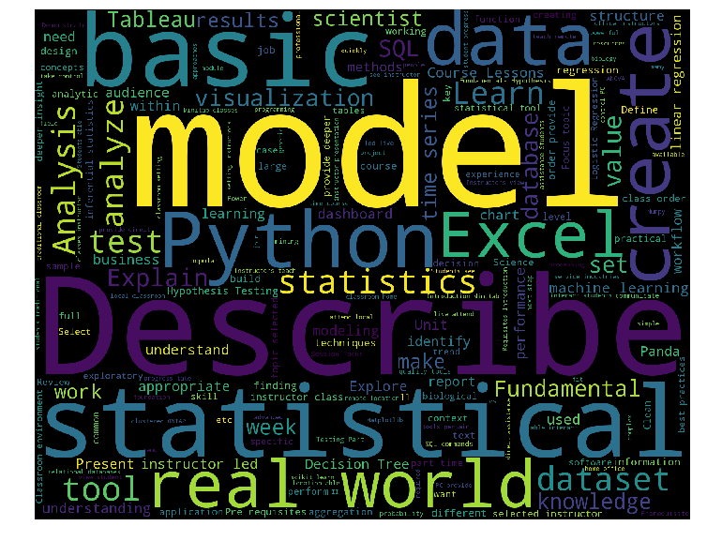
Big Data course name course description

Slide 18
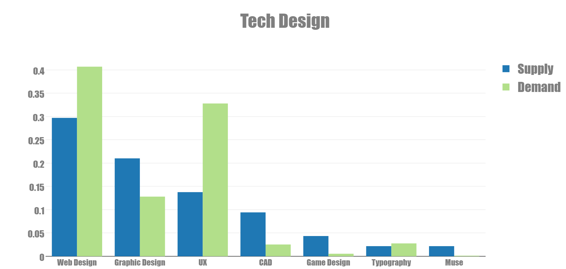

Slide 19
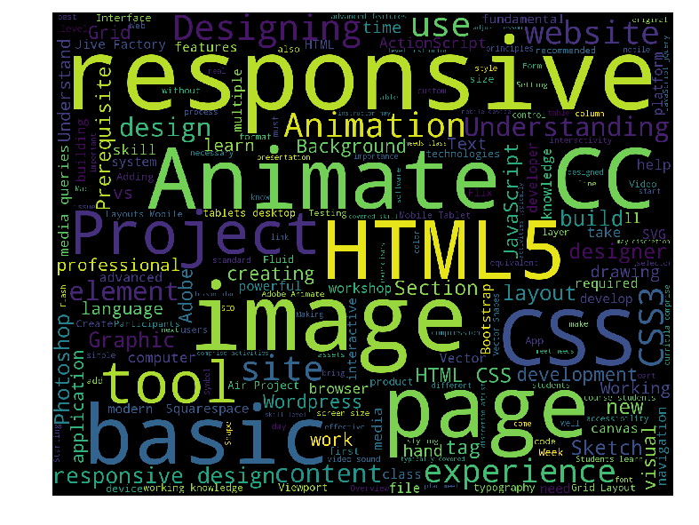
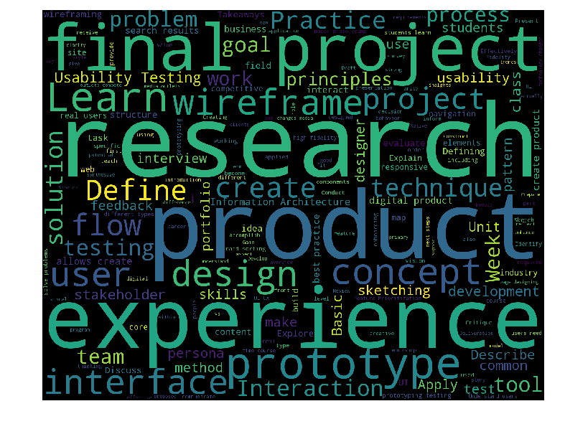
Web Design UX
Notes:
Course description

Slide 20
Overview

Slide 21
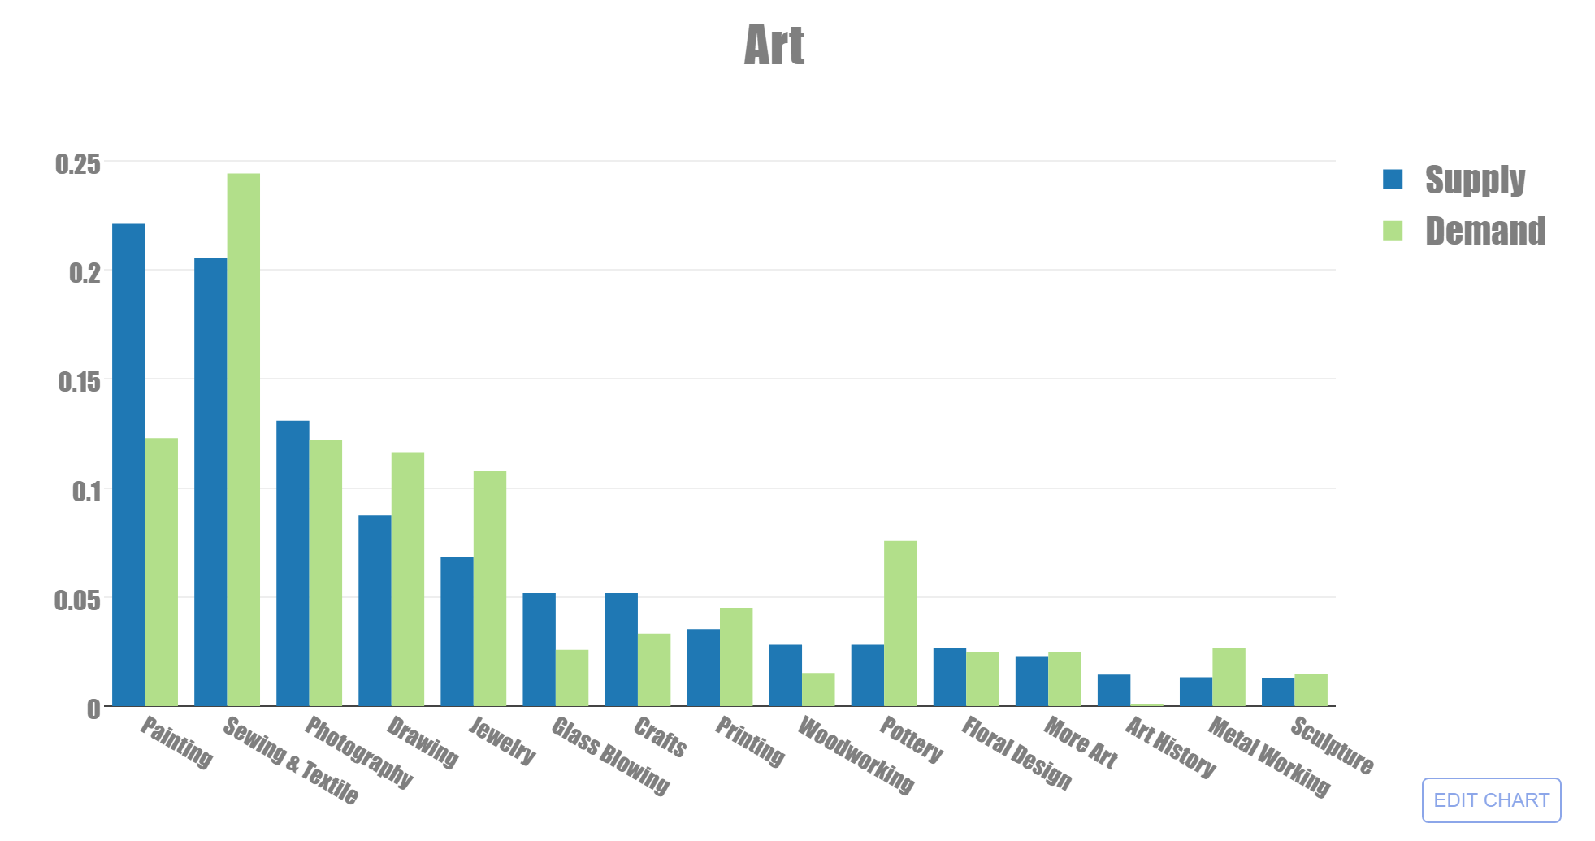

Slide 22
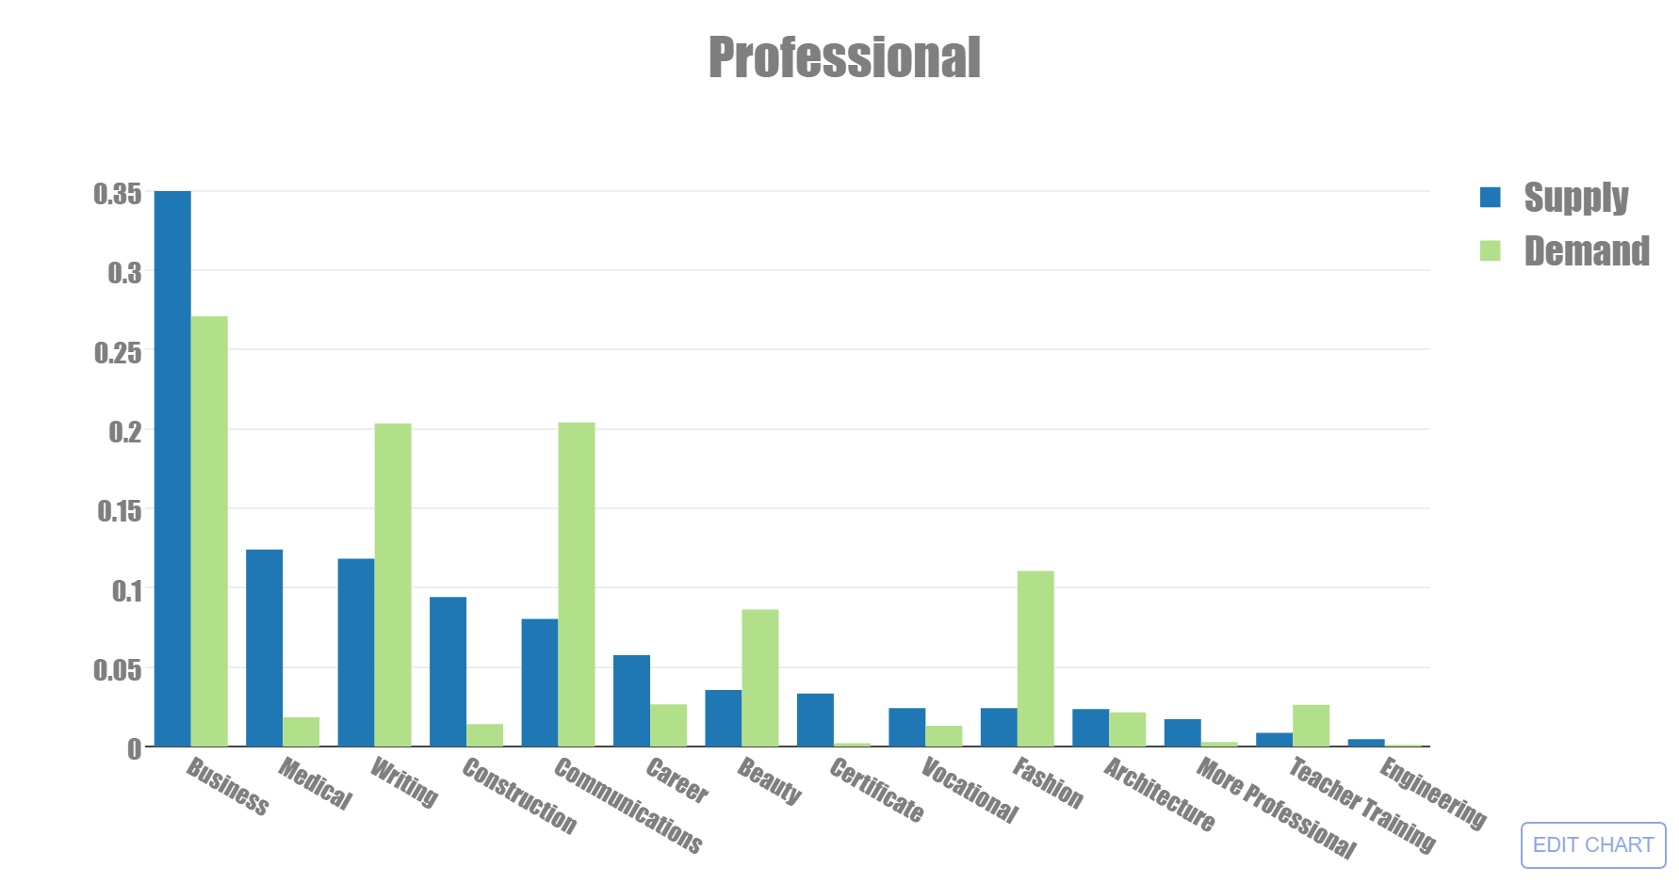
https://plot.ly/~qiuzhou/2/professional/

Slide 23
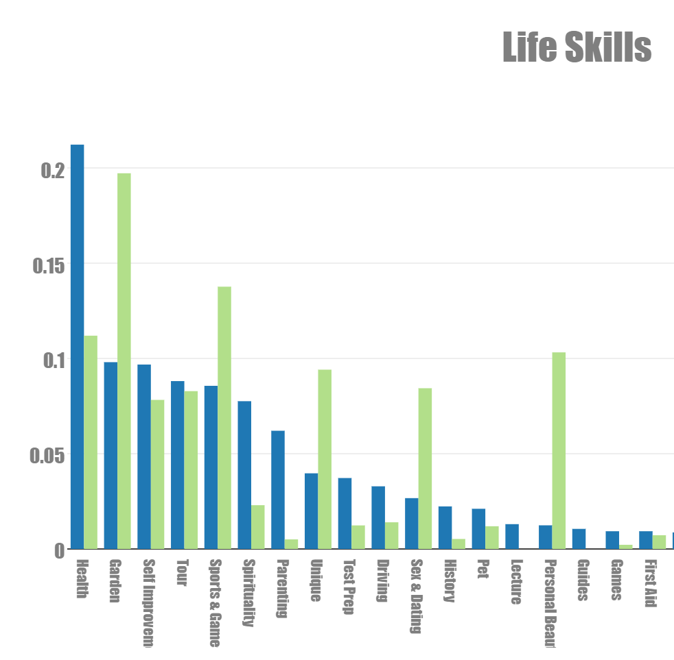

Slide 24
Recommendation
Software training schools
provide more visual software training and less amount of Microsoft software courses
Coding schools
shift more focus on intro to programming courses than intermediate level / advanced level of languages
IT educational institutions
offer more big data course but fewer on Network and Cyber Security topics
Art courses providers
Consider more handcraft course like sewing & textile, Jewelry and Pottery

Slide 25
Appendix

Slide 26
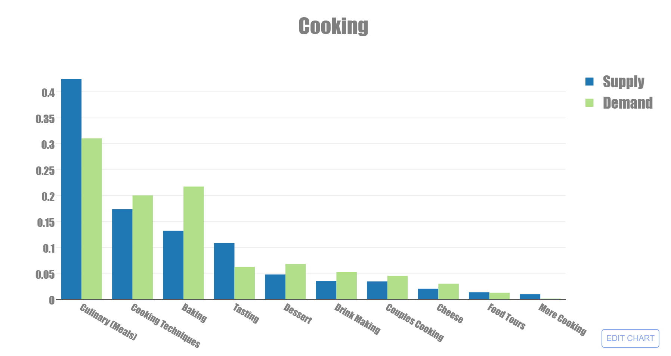

Slide 27
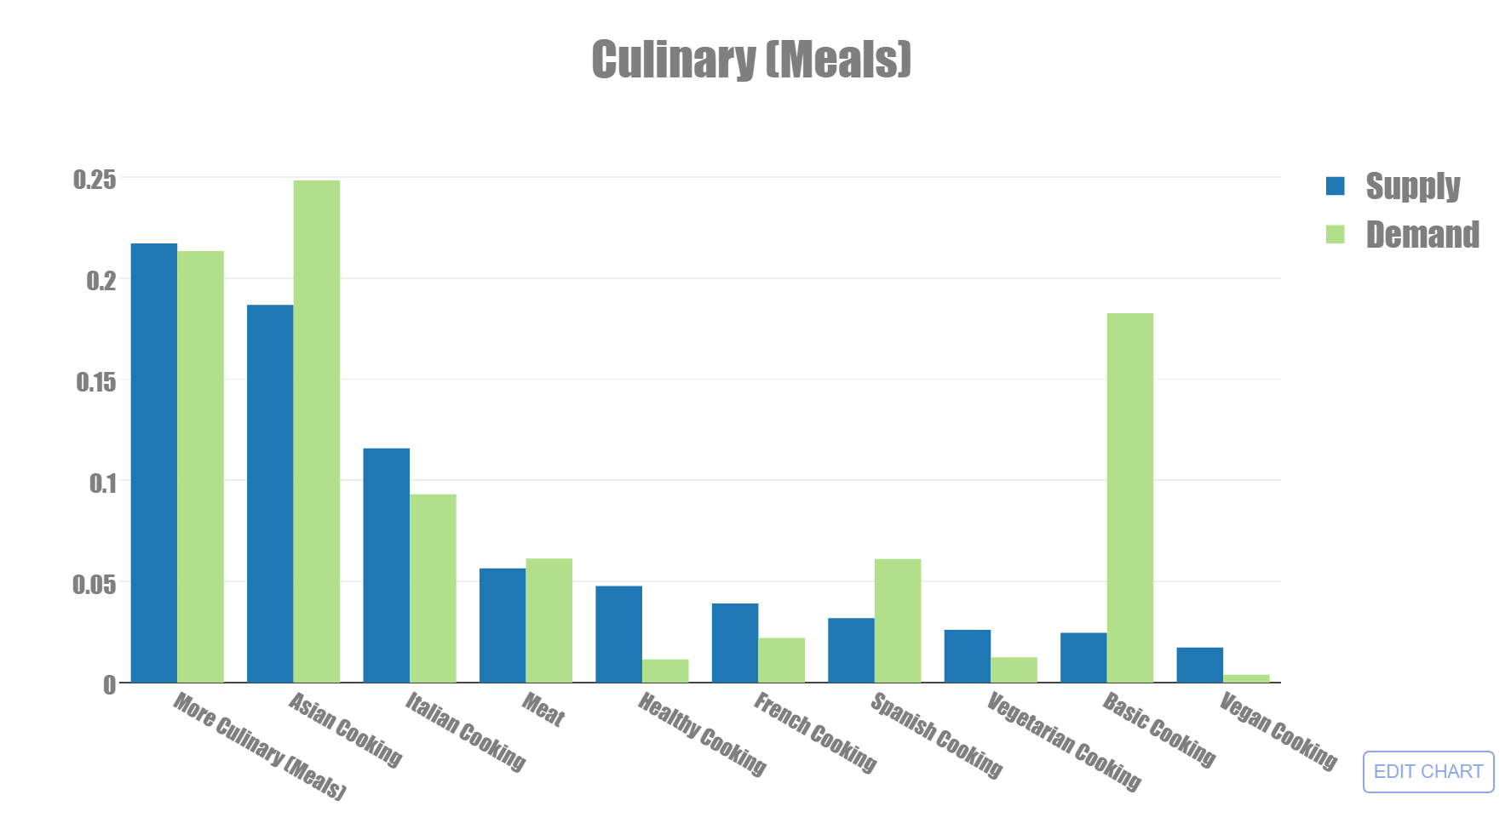

Slide 28
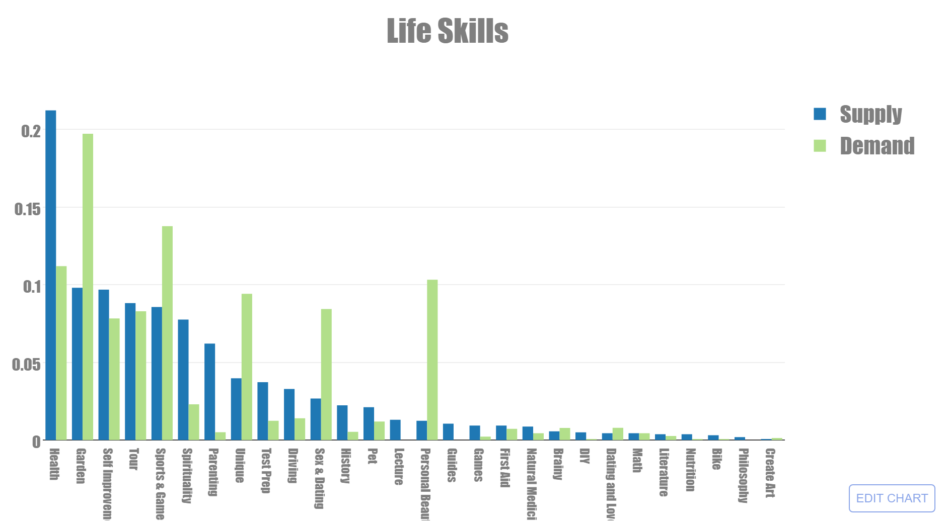

Slide 29
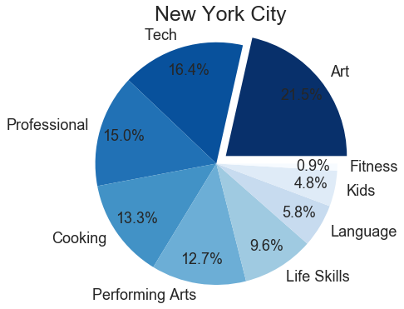
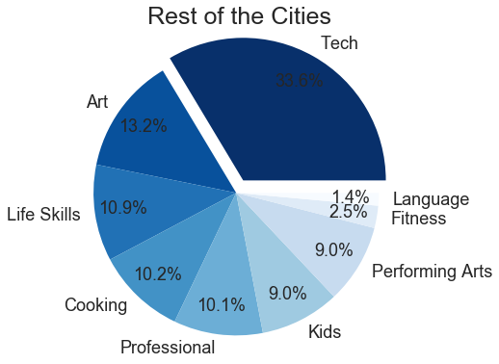

Slide 30
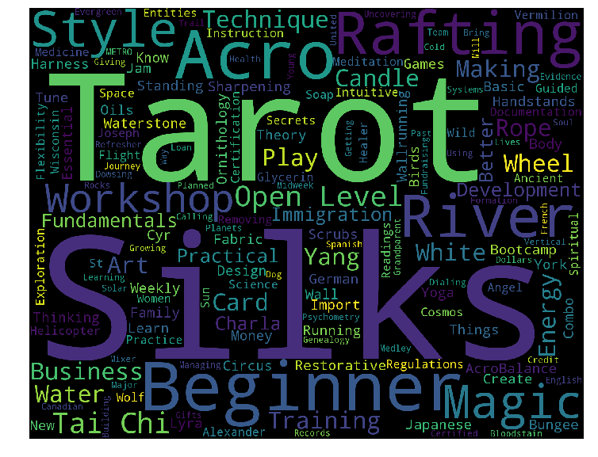
Life Skills - Unique Classes

Slide 31
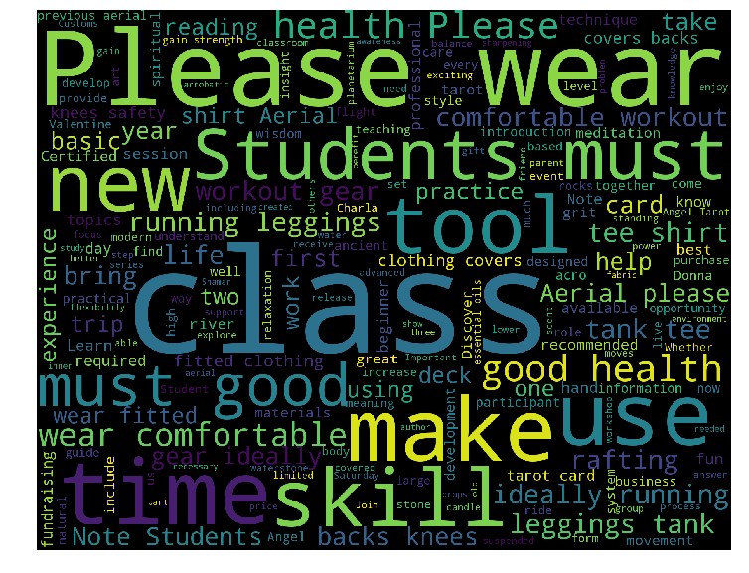

Slide 32
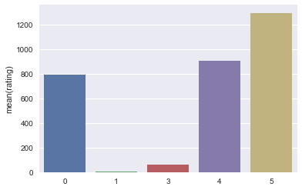
Review Distribution

Slide 33
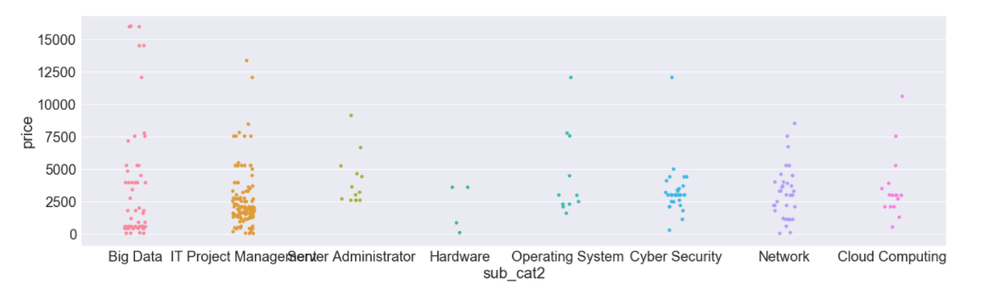

Slide 34
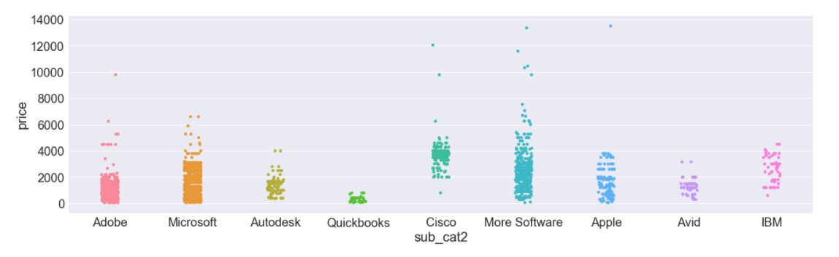

Slide 35
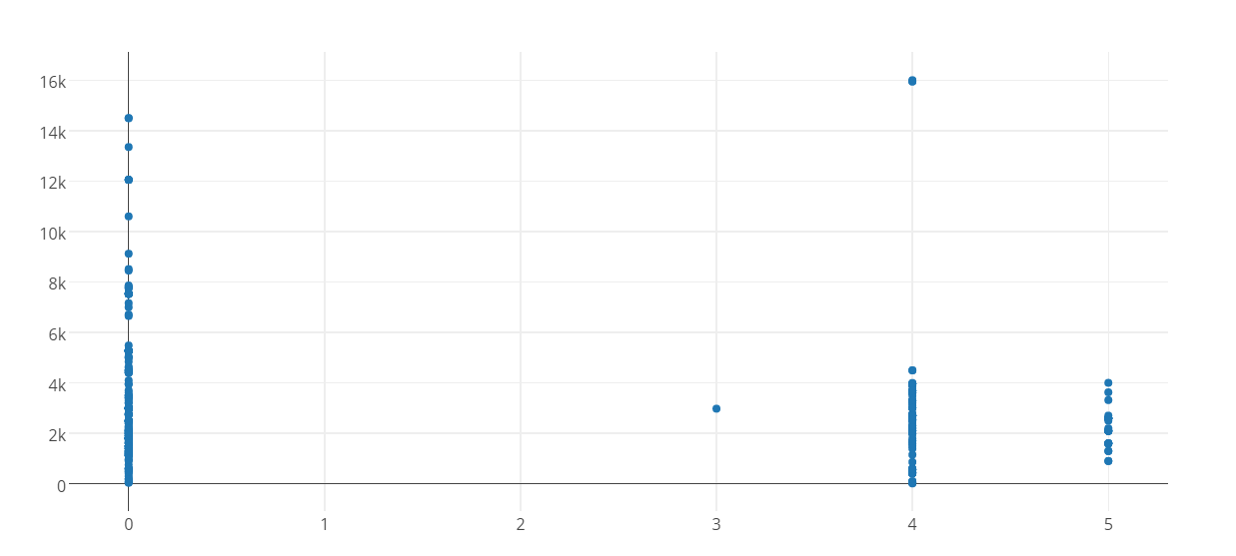

Slide 36
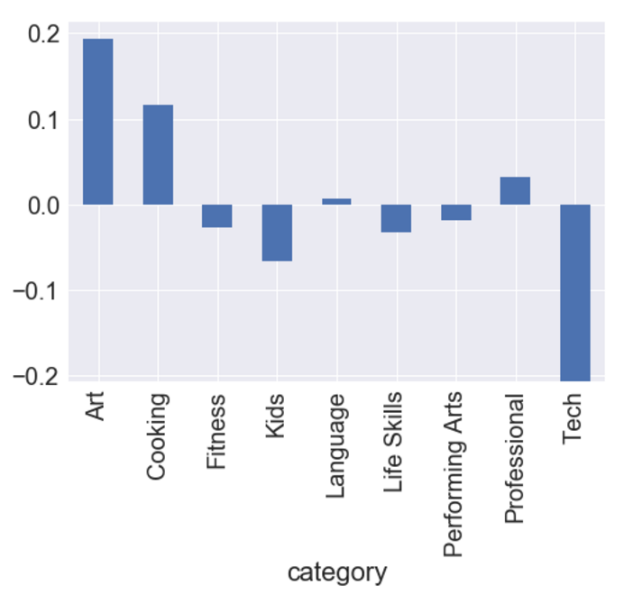

Slide 37
